Slide 1
Course Name : Data Mining
Dr. Vijayalakshmi Anand
Professor ,Computer science department, BITS- Pilani

Slide 2

The slides presented here are obtained from the authors of the books and from various other contributors. I hereby acknowledge all the contributors for their material and inputs.
I have added and modified a few slides to suit the requirements of the course.

Slide 3
Textbooks/Reference Books
Text Books
T1 | Tan P. N., Steinbach M & Kumar V. “Introduction to Data Mining” Pearson Education, 2006
T2 | Data Mining: Concepts and Techniques, Third Edition by Jiawei Han and Micheline Kamber Morgan Kaufmann Publishers, 2011
Reference Book(s) & other resources
R1 | Predictive Analytics and Data Mining: Concepts and Practice with RapidMiner by Vijay Kotu and Bala Deshpande Morgan Kaufmann Publishers © 2015
 | Additional references may be given during lectures

Slide 4
Modular Structure
No | Title of the Module
M1 | Introduction to Data Mining
M2 | Data Preprocessing
M3 | Data Exploration
M4 | Classification and Prediction
M5 | Clustering
M6 | Association Analysis
M7 | Anomaly Detection
M8 | Data mining on unstructured (Big) data
M9 | Data Mining Applications

Slide 5
Evaluation Scheme
No | Name | Type | Weight
1. | Quiz-I | Online | 5%
 | Quiz-II | Online | 5%
 | Assignment | Group | 10%
2. | Mid-Semester Test |  | 30%
3. | Comprehensive Exam |  | 50%

Slide 6
Session#1 – Introduction to Data Mining
Data Mining basics
Why Data Mining
What is Data Mining
Techniques used in DM
Multidimensional View of Data Mining
Data Mining Task
Classification
Clustering
Association Rule Discovery
Sequential Pattern Discovery
Regression
Deviation Detection
Data Mining Process
Challenges in DM

Slide 7
Motivation: “Necessity is the Mother of Invention”
Data explosion problem
Automated data collection tools and mature database technology lead to tremendous amounts of data stored in databases, data warehouses and other information repositories
We are drowning in data, but starving for knowledge!
Solution: data mining
Extraction of interesting knowledge (rules, regularities, patterns, constraints) from data in large databases
7

Slide 8

Why Mine Data? Commercial Viewpoint
Lots of data is being collected and warehoused
Web data, e-commerce
purchases at department/ grocery stores
Bank/Credit Card transactions
Competitive Pressure is Strong
Provide better, customized services for an edge (e.g. in Customer Relationship Management)

Slide 9
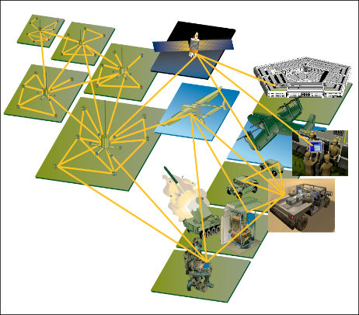
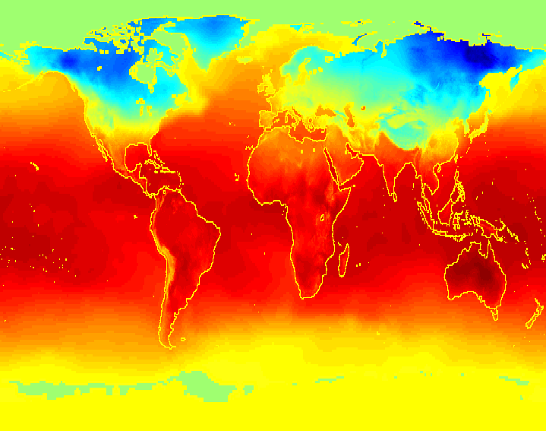
Why Mine Data? Scientific Viewpoint
Data collected and stored at enormous speeds (GB/hour)
remote sensors on a satellite
telescopes scanning the skies
microarrays generating gene expression data
scientific simulations generating terabytes of data
Data mining may help scientists
in classifying and segmenting data
in Hypothesis Formation

Slide 10
Evolution of Database Technology
1960s
Data collection, database creation, IMS and network DBMS
1970s
Relational data model, RDBMS implementation
1980s
RDBMS, Extended data models
1990s
Data mining , data warehousing, web databases
2000s
Stream data management and mining
Data mining and its applications
Web technology and global information systems

Slide 11
Definition of Data Mining
Data mining (knowledge discovery from data)
Extraction of interesting (non-trivial, implicit, previously unknown and potentially useful) patterns or knowledge from huge amount of data
Data mining: a misnomer?
Alternative names
Knowledge discovery (mining) in databases (KDD), knowledge extraction, data/pattern analysis, data archeology, data dredging, information harvesting, business intelligence, etc.

Slide 12
Examples: What is (not) Data Mining?
What is not Data Mining?
Look up phone number in phone directory
Query a Web search engine for information about “Amazon”
What is Data Mining?
Certain names are more prevalent in certain US locations (O’Brien, O’Rurke, O’Reilly… in Boston area)
Group together similar documents returned by search engine according to their context (e.g. Amazon rainforest, Amazon.com,)

Slide 13
Technologies used in DM
Data mining has incorporated many techniques from other domains such as statistics, machine learning, pattern recognition, database and data warehouse systems, information retrieval, visualization, algorithms, high-performance computing, and many application
Machine
Learning
Pattern
Recognition
Statistics
Applications
Data Mining
Visualization
Algorithm
Database
Technology
High-Performance
Computing

Slide 14
Data Mining on Diverse kinds of Data
Besides relational database data (from operational or analytical systems), there are many other kinds of data that have diverse forms and structures and different semantic meanings.
Diversity of data brings in new challenges such as handling special structures (e.g., sequences, trees, graphs, and networks) and specific semantics (such as ordering, image, audio and video contents, and connectivity)

Slide 15
Why traditional technique is not suitable for Bigdata
Traditional Techniques may be unsuitable due to
Enormity of data
High dimensionality of data
Heterogeneous, distributed nature of data
15

Slide 16
Multidimensional view of data Mining
Data to be mined
Database data, data warehouse, transactional data, stream, time series, text and web, multimedia, graphs and social and information network
Knowledge to be mined(Data mining functions)
Characterization, discrimination, association, classification, clustering, trend/deviation, outlier analysis etc.
Descriptive vs. predictive data mining
Multiple/integrated functions and mining at multiple levels
16

Slide 17
Multidimensional view of data Mining
Techniques utilized
Data intensive, data warehouse(OLAP), machine learning, statistics, pattern recognition, visualization, high performance etc.
Applications adapted
Retail , telecommunications, banking, fraud analysis, bio-data mining, stock market analysis, text mining, web mining etc.

Slide 18
Datamining Method and classification
Methods
Prediction Method
Use some variables to predict unknown or future values of other variables
Description Method
Find human-interpretable patterns that describe the data
Classification of datamining
Supervised learning
Unsupervised learning

Slide 19
Data Mining Tasks
Common data mining tasks
Classification [Predictive]
Clustering [Descriptive]
Association Rule Discovery [Descriptive]
Sequential Pattern Discovery [Descriptive]
Regression [Predictive]
Deviation Detection [Predictive]

Slide 20
Classification: Definition
Given a collection of records (training set )
Each record contains a set of attributes, one of the attributes is the class.
Find a model for class attribute as a function of the values of other attributes.
Goal: previously unseen records should be assigned a class as accurately as possible.
A test set is used to determine the accuracy of the model. Usually, the given data set is divided into training and test sets, with training set used to build the model and test set used to validate it.

Slide 21
Classification Example
categorical
categorical
continuous
class
Test
Set
Learn
Classifier
Training
Set
Model

Slide 22
Classification: Application 1
Direct Marketing
Goal: Reduce cost of mailing by targeting a set of consumers likely to buy a new cell-phone product.
Application:
Retail industry-by providing useful and accurate trends.
Credit company –to identify customers to be interested
Approach:
Use the data for a similar product introduced before.
We know which customers decided to buy and which decided otherwise. This {buy, don’t buy} decision forms the class attribute.
Collect various demographic, lifestyle, and company-interaction related information about all such customers.
Type of business, where they stay, how much they earn, etc.
Use this information as input attributes to learn a classifier model.
From [Berry & Linoff] Data Mining Techniques, 1997

Slide 23
Classification: Application 2
Fraud Detection
Goal: Predict fraudulent cases in credit card transactions.
Approach:
Use credit card transactions and the information on its account-holder as attributes.
When does a customer buy, what does he buy, how often he pays on time, etc
Label past transactions as fraud or fair transactions. This forms the class attribute.
Learn a model for the class of the transactions.
Use this model to detect fraud by observing credit card transactions on an account.

Slide 24
Classification: Application 3
Customer Attrition/Churn:
Goal: To predict whether a customer is likely to be lost to a competitor.
Approach:
Use detailed record of transactions with each of the past and present customers, to find attributes.
How often the customer calls, where he calls, what time-of-the day he calls most, his financial status, marital status, etc.
Label the customers as loyal or disloyal.
Find a model for loyalty.
From [Berry & Linoff] Data Mining Techniques, 1997

Slide 25
Classification: Application 4
Sky Survey Cataloging
Goal: To predict class (star or galaxy) of sky objects, especially visually faint ones, based on the telescopic survey images (from Palomar Observatory).
3000 images with 23,040 x 23,040 pixels per image.
Approach:
Segment the image.
Measure image attributes (features) - 40 of them per object.
Model the class based on these features.
Success Story: Could find 16 new high red-shift quasars, some of the farthest objects that are difficult to find!
From [Fayyad, et.al.] Advances in Knowledge Discovery and Data Mining, 1996

Slide 26
Clustering Definition
Given a set of data points, each having a set of attributes, and a similarity measure among them, find clusters such that
Data points in one cluster are more similar to one another.
Data points in separate clusters are less similar to one another.
Similarity Measures:
Euclidean Distance if attributes are continuous.
Other Problem-specific Measures.

Slide 27
Illustrating Clustering
Intercluster –less distance
Intracluster –more distance
Euclidean Distance Based Clustering in 3-D space

Slide 28
Clustering: Application 1
Market Segmentation:
Goal: subdivide a market into distinct subsets of customers where any subset may conceivably be selected as a market target to be reached with a distinct marketing mix.
Approach:
Collect different attributes of customers based on their geographical and lifestyle related information.
Find clusters of similar customers.
Measure the clustering quality by observing buying patterns of customers in same cluster vs. those from different clusters.

Slide 29
Clustering: Application 2
Document Clustering:
Goal: To find groups of documents that are similar to each other based on the important terms appearing in them.
Approach: To identify frequently occurring terms in each document. Form a similarity measure based on the frequencies of different terms. Use it to cluster.
Gain: Information Retrieval can utilize the clusters to relate a new document or search term to clustered documents.

Slide 30
Association Rule Discovery: Definition
Given a set of records each of which contain some number of items from a given collection;
Produce dependency rules which will predict occurrence of an item based on occurrences of other items.
Example of Association Rules
TID | Items
1 | Bread, Milk
2 | Bread, Diaper, Butter, Beans
3 | Milk, Diaper, Butter, Coke
4 | Bread, Milk, Diaper, Butter
5 | Bread, Milk, Diaper, Coke
{Diaper} → {Butter}, {Milk, Bread} → {Beans, Coke}, {Butter, Bread} → {Milk},

Slide 31
Applications
Market basket analysis
Medical Diagnosis
Census data

Slide 32
Regression
Predict a value of a given continuous valued variable based on the values of other variables, assuming a linear or nonlinear model of dependency.
Greatly studied in statistics, neural network fields.
Examples:
Predicting sales amounts of new product based on advetising expenditure.
Predicting wind velocities as a function of temperature, humidity, air pressure, etc.
Time series prediction of stock market indices.

Slide 33
Deviation/Anomaly Detection
Detect significant deviations from normal behavior
Applications:
Credit Card Fraud Detection
Network Intrusion Detection

Slide 34
Data Mining Process

Slide 35
DM Process
The standard data mining process involves
understanding the problem,
preparing the data (samples),
developing the model,
applying the model on a data set to see how the model may work in real world, and
production deployment.

Slide 36
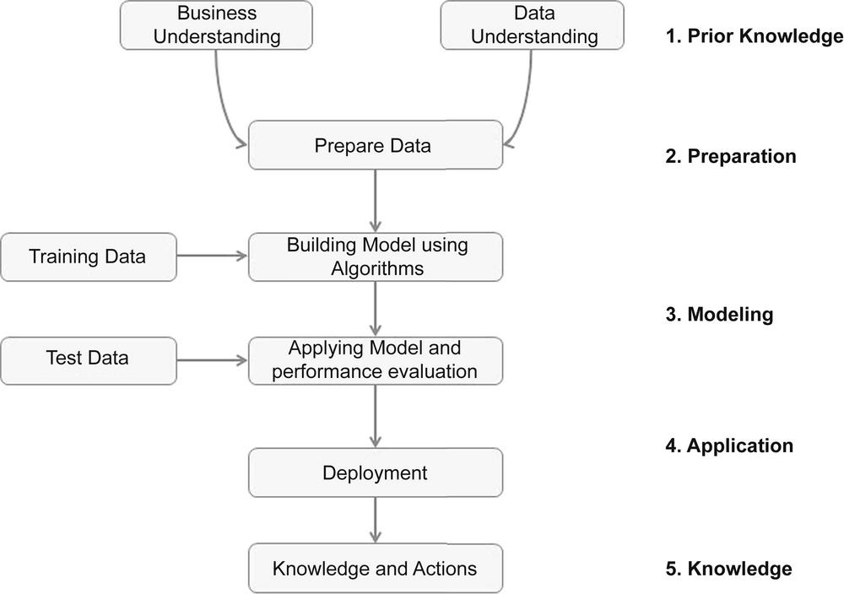
Generic Data Mining Process

Slide 37
Prior Knowledge
Data Mining tools/solutions identify hidden patterns.
Generally we get many patterns
Out of them many could be false or trivial.
Filtering false patterns requires domain understanding.
Understanding how the data is collected, stored, transformed, reported, and used is essential.

Slide 38
Data Preparation
Data cleaning
Missing values
Outliers / anomalies in the data set
Feature Selection
Transformation

Slide 39
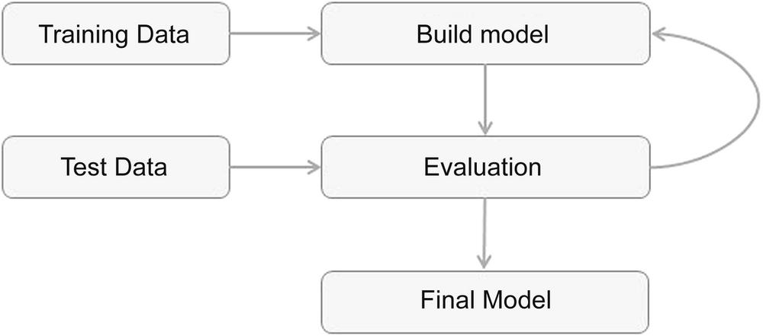
Modeling

Slide 40
Application
The model deployment stage considerations:
assessing model readiness,
technical integration,
response time,
model maintenance,
and assimilation

Slide 41
Knowledge and action
easy to understand for non-technical stakeholders.
A final project report is created

Slide 42
CRISP-DM
A popular data mining process frameworks is CRISP-DM (Cross Industry Standard Process for Data Mining).
This framework was developed by a consortium of companies involved in data mining in 1990
Advantages

Slide 43
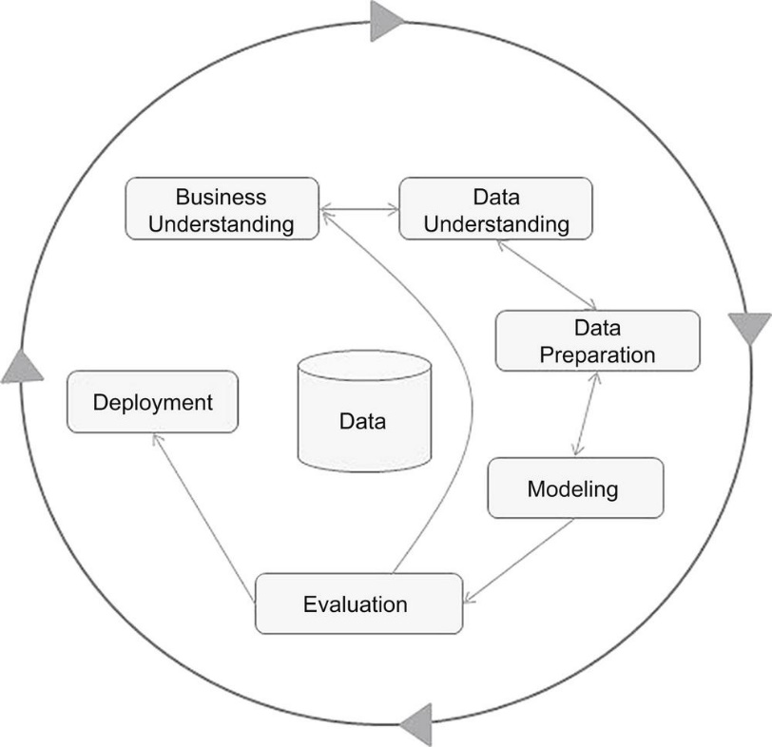
CRISP data mining framework

Slide 44
DM issues/Challenges

Slide 45
DM Issues/Challenges – Mining Methodology
Mining various and new kinds of knowledge/different dimension
Handling uncertainty, noise, or incompleteness of data
Pattern evaluation

Slide 46
DM Issues/Challenges – User Interaction
Interactive mining
Incorporation of background knowledge
Ad hoc data mining and data mining query languages
Presentation and visualization of data mining results
DM Issues/Challenges - Efficiency and Scalability
Efficiency and scalability of data mining algorithms
Parallel, distributed, and incremental mining algorithms

Slide 47
DM Issues/Challenges - Diversity of Database Types
Handling complex types of data
Mining dynamic, networked, and global data repositories
DM Issues/Challenges - Society
Social impacts of data mining
Privacy-preserving data mining
Invisible data mining

Slide 48
Thank You

